Slide 1

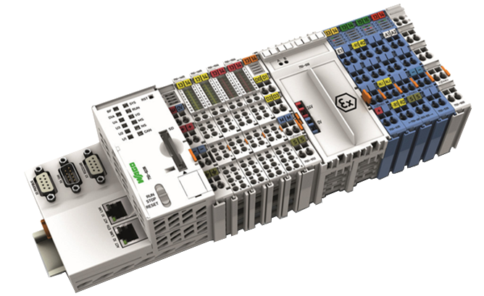
WAGO-I/O-SYSTEM Hardware
2
Power supply
Handling
Communication
Hardware configuration
Diagnostic
Web-based Management
Notes:
WAGO-I/O-SYSTEM 750, 753, 758 for scalable automation solutions
Fine modularity and fieldbus-independence are hallmarks of the WAGO-I/O-SYSTEM, which boasts worldwide approvals for a diverse range of applications. During development, great care was taken to ensure the system could account for all the requirements placed on decentralized fieldbus systems.
Designed to Meet Practical Requirements
I/O modules with pluggable connectors (753 Series)
Fine granularity: I/O module accommodates 1, 2, 4, 8 or 16 channels
Fieldbus-independent: Fieldbus couplers and controllers for the most common fieldbus protocols and industrial ETHERNET standards
A sound investment: Fieldbus-independent node design easily accommodates new bus standards while retaining the I/O modules
Clear Identification: Color-coded group marker carriers and WAGO WSB markers for clamping units
Scalable performance: With economy and standard couplers as well as programmable controllers on through to comprehensive IPCs
High-performance: Controllers for distributed control networks according to
IEC 61131-3

Slide 2
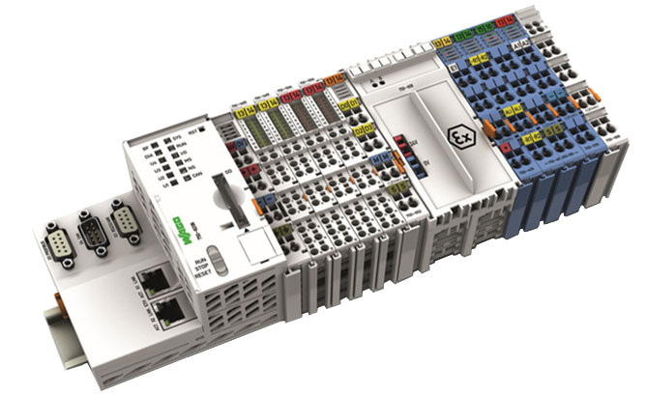
Fielbus nodes
The configuration
◆
❖
⬥
◆
Controller
❖
I/O modules (max. 64)
⬥
End module
Notes:
Total extension
The length of the module assembly that can be connected to the controller is 780 mm. The width of the end module is 12 mm. When assembled, the I/O modules have a maximum length of 768 mm.
Examples:
64 I/O modules of 12 mm width can be connected to a controller. 32 I/O modules of 24 mm width can be connected to a controller.
.

Slide 3
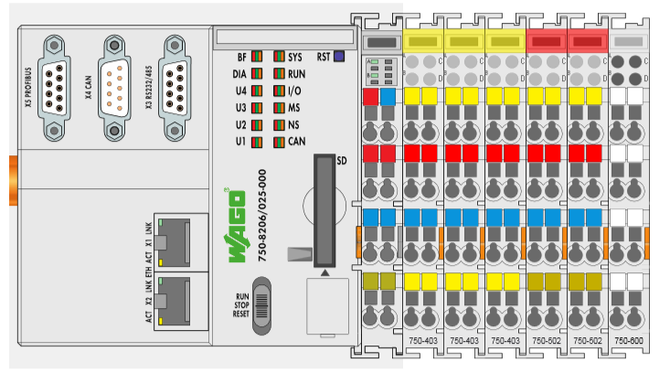
Power Supply
The potential levels
Fieldbus, external interfaces
Module electronics
External peripheries

Slide 4
Power Supply
Supply with electrical isolation
Bus coupler and Bus modules electronics:
external: 24 VDC, max. 500 mA
internal: 5 VDC, 2000 mA
External peripheries:
24 VDC, max. 10 A

Slide 5
Power Supply
Supply without electrical isolation

Slide 6
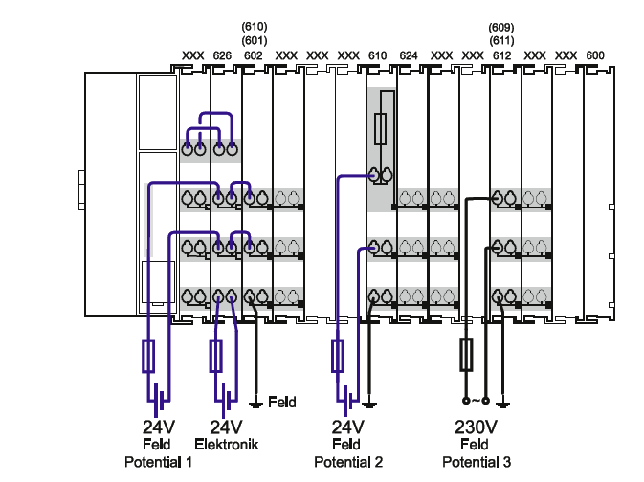
Power Supply
Schematic
Notes:
3.6.5 Supply example
Additional information for designing a ring feeding
In order to increase system safety, a ring feeding of the ground potential is recommended. Thus, the ground potential is maintained, in the event that a bus terminal is pulled from the potential group.
In ring feeding, the grounding conductor is connected to the beginning and end of a potential group.
Please see the additional information for designing a ring feeding in chapter "Grounding"> "protective earth" ring feeding.
System and field supply must be isolated!
The system supply and field supply must be isolated to ensure bus operation in the event of short circuits on the actuator side.

Slide 7
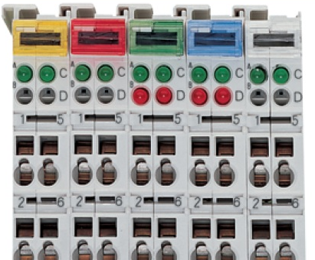
Color-coding
yellow
Digital inputs
red
Digital outputs
green
Analog inputs
blue
Analog outputs
Specialty functions
750 – 4xx inputs
750 – 5xx outputs
750 – 6xx Special and system modules

Slide 8
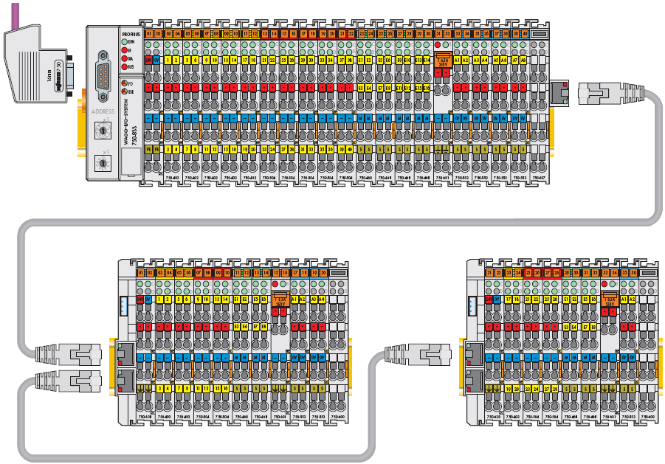
Internal Data Bus Extension

Slide 9
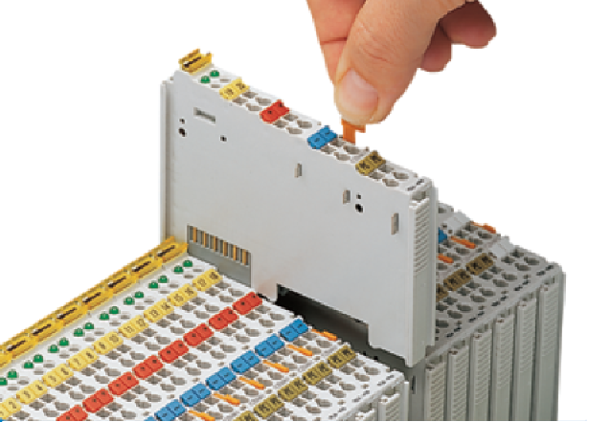
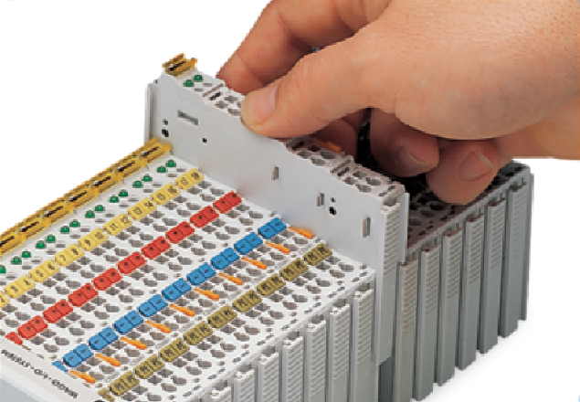
Handling the I/O modules
Assembly/Removal
Assembly: Insert until the module engages noticeably
Removal: Pull on the orange actuating element
Mount terminals if free of voltage
Practical tips
Be careful with the blade contacts when removing the terminal (risk of injury)
Keep gold contacts clean and do not touch with fingers
Deposit terminal with the printed side up

Slide 10
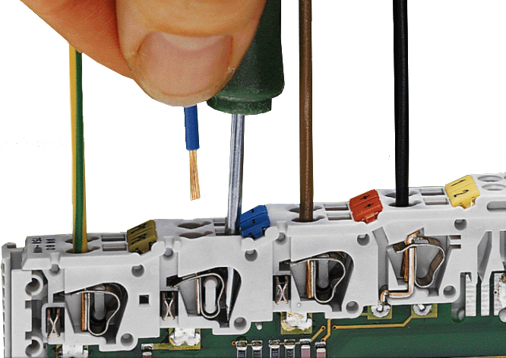
Wiring the I/O modules
CAGE CLAMP® Connection
A universal system
Suitable for all copper wires from 28 to 2 AWG (0.08 mm² to 2.5 mm²)
One conductor per clamping unit
Clamping of the wire without damage through unique design
Gastight contact area between conductor and current bar
Vibration and shock resistant
Simple, easy-to-use design
Fast and maintenance-free

Slide 11
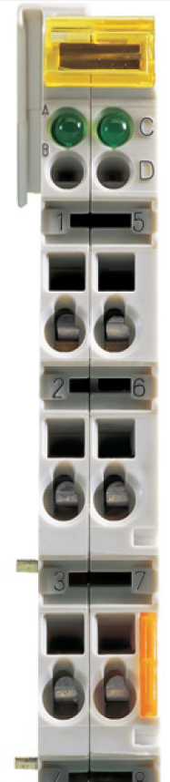
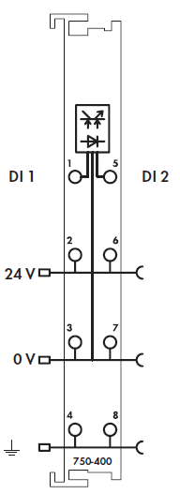
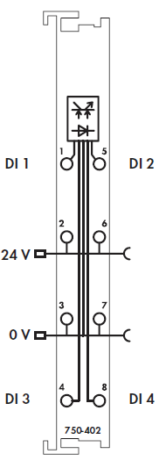
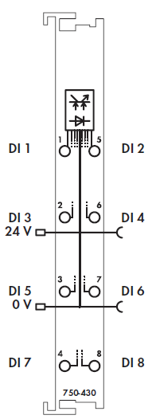
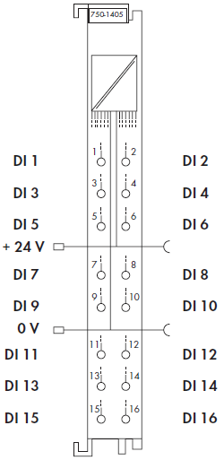
Connect the peripherals
Special features of the digital modules
2 channel 4 channel 8 channel 16 channel
Marking area of the modules poins printing
The marking area of the modules points printing 1-8 fits usually not to the channel occupancy

Slide 12
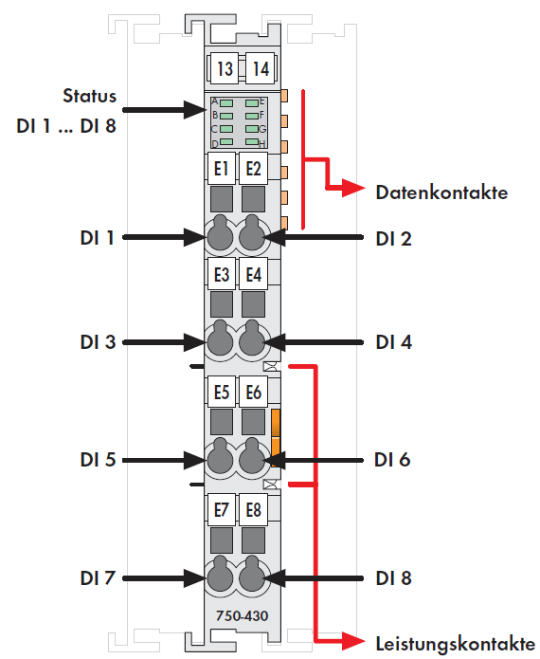
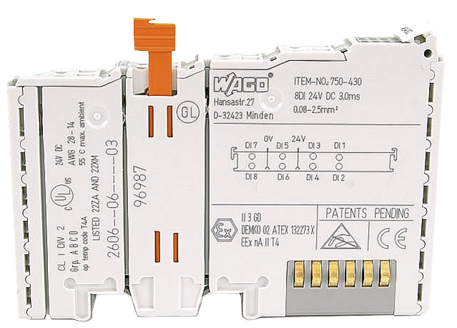
Connect the peripherals
Wiring information from the data sheet
Online or catalog or on the board

Slide 13
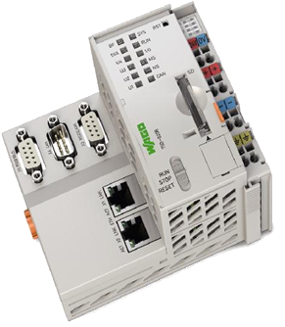
Configuration of the Controller
TCP IP settings
Runtime system
Switch/ LED
Further settings
Technichal data

Slide 14

Communication
Connection between e!COCKPIT PC and Controller
Network cable
Configuration
Program download
USB service cable
Configuration
Notes:
The communication between PC and controller takes place using standard network interface cards via Ethernet.

Slide 15
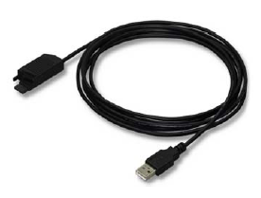
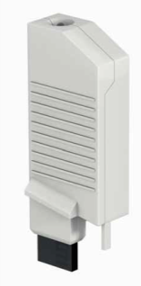
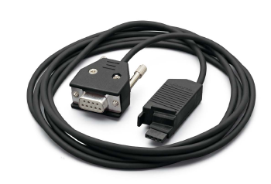
Serial communication interface
For IP configuration only
USB service cable
750-923 (2.5 m)
750-923/000-001 (5 m)
Bluetooth® funkadapter 750-921
Serial service cable
750-920
Notes:
(From the WAGO-I/O-CHECK manual)
5.1 Configuring the communication connection
The following work steps are required to set up the communication connection:
Switch off the power supply of the fieldbus controller.
Open the configuration interface of the fieldbus controller.
Warning! Do NOT touch the interface contacts of the fieldbus controller with your fingers or any conductive objects!
Connect the configuration interface to the appropriate socket of the communication cable 750-920.
Connect the Sub-D socket of the communication cable with a free serial interface of the computer.
WAGO-I/O-CHECK is now able to communicate with the node.

Slide 16
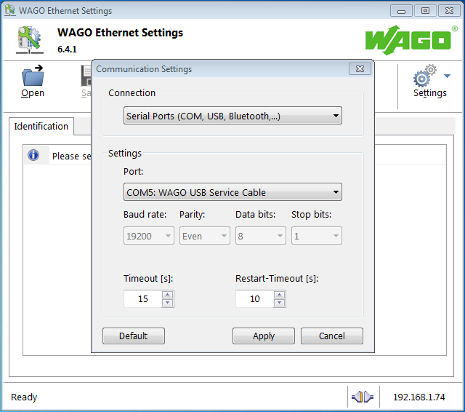
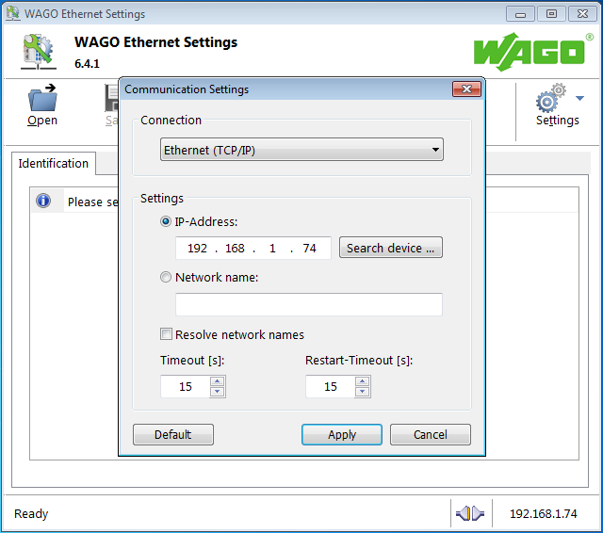
Hardware configuration – IP address
WAGO ETHERNET Settings
Two connection options
Via a USB service cable
Over the network

Slide 17
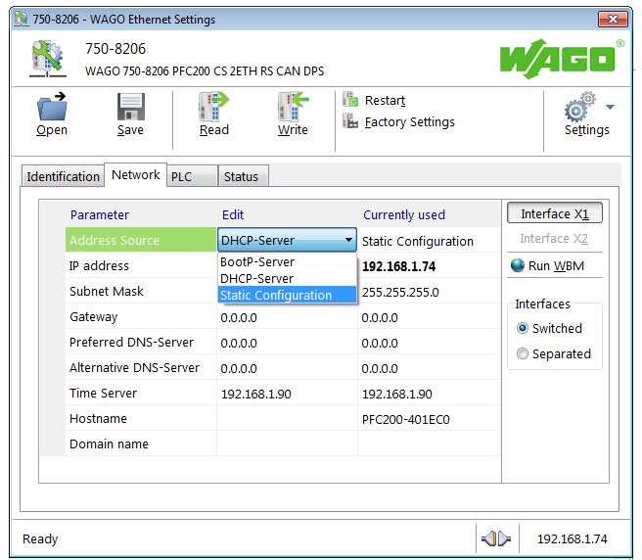
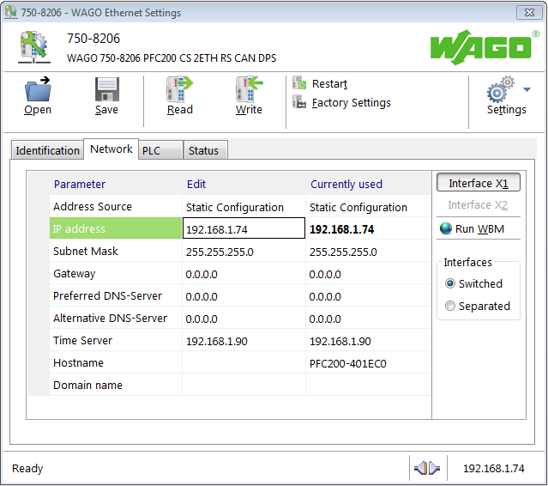
Hardware configuration – IP address
WAGO ETHERNET Settings
Source: static configuration
To set IP settings => to write

Slide 18
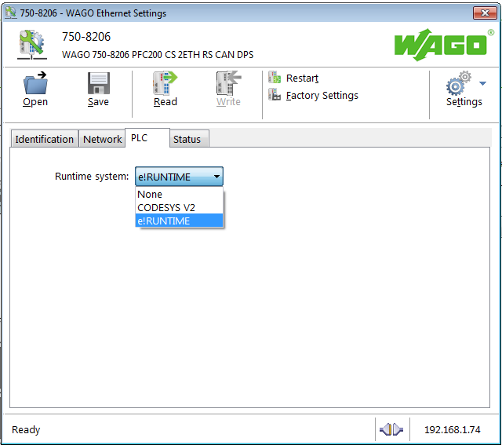


Hardware configuration – runtime system
WAGO ETHERNET Settings
Donʼt forget
Switch the runtime system – from CODESYS V2 to e!Runtime
e!Runtime
V2
runtime system

Slide 19
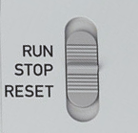
Operating mode switch
Position | Activation | Function
RUN | Switch RUN | Application Start
STOP | Switch STOP | Application Stop
RESET | Switch RESET > 2s Switch RESET > 7s | Reset warm Reset cold
If the operating mode switch is in STOP position, the Controller can not be started from e!COCKPIT.

Slide 20
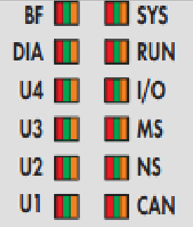
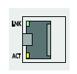
Diagnostic
Diagnostic LEDs of PFC 200
BF/DIA Bus diagnostic PROFIBUS
CAN Bus diagnostic CANopen
MS/NS Bus diagnostic Ethernet
I/O Diagnostic K-Bus
U1…U4 User diagnostic
LNK ACT Active network connection

Slide 21
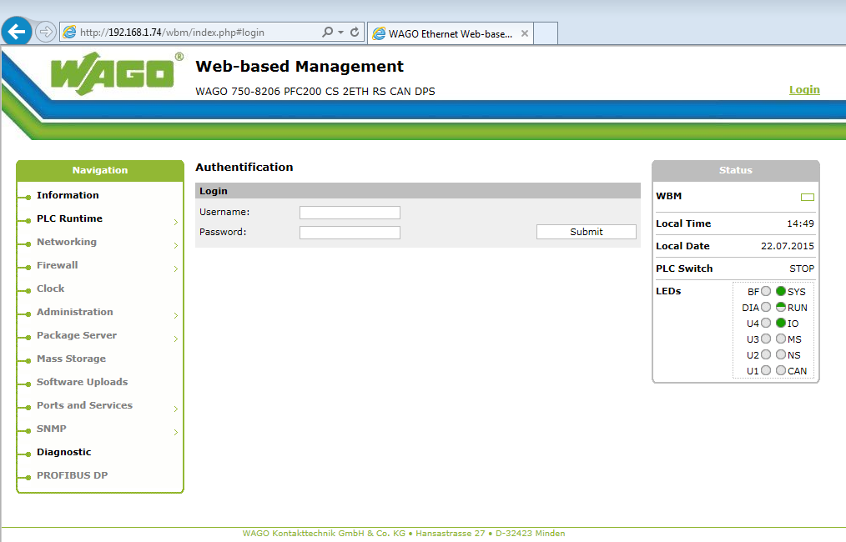
Web-based Management
Username: admin
Password: wago

Slide 22
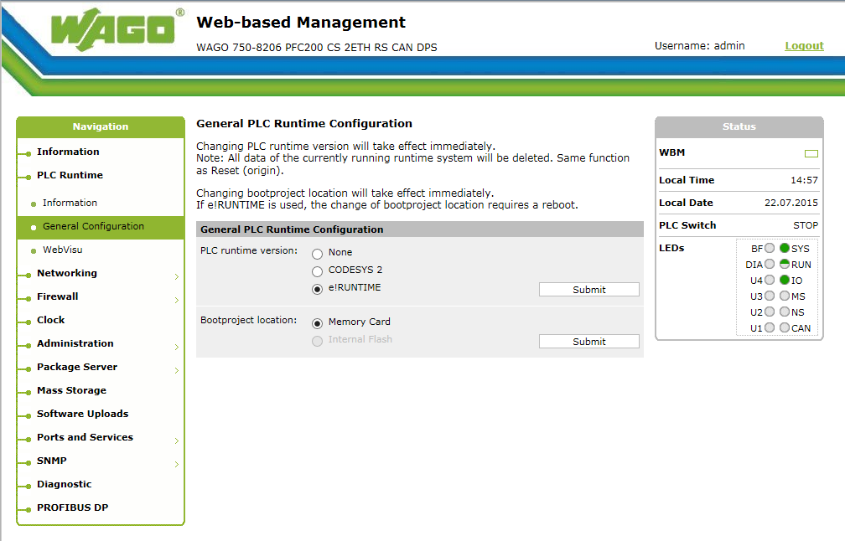
Web-based Management

Slide 23
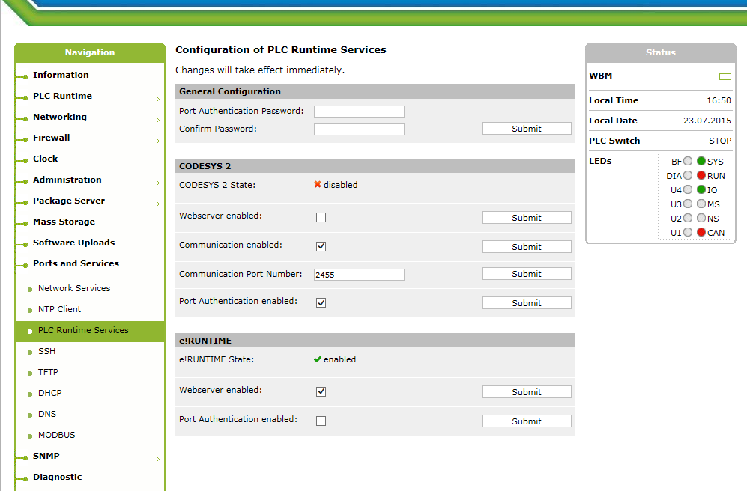
Web-based Management – additional settings
Webserver enabled: for the using e!COCKPIT web visualization port authentication switches e!COCKPIT password on/ off (Default: admin/ wago)

Slide 24
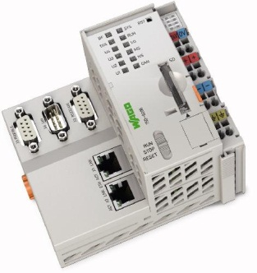
Technical data – 8202 … 8206
Data protocols: Modbus TCP/IP, Netzwerkvariable, CANopen, ProfibusDP
Service protocols : HTTP, BootP, DHCP, DNS, SNTP, FTP, SNMP
ETHERNET type: | 100 Mbit/s
CPU: | 32 bit
Program memory: | 16 Mbyte
Data memory: | 64 Mbyte
Retain memory: | 128 kbyte
Filesystem: | 256 Mbyte

